Slide 1
SSCP2018
Intro and info

Slide 2





SSCP2018
Summer School in Computational Physiology

Slide 3
Access and meal cards
Access to Simula (main building, Simula entrances) until the end of 29th June
Cards are also meal cards for the cantines
Discount on the cost of meals in the cantine
Preloaded with 500 NOK per card (average cost per meal is 35 NOK) – should be enough for 10-12 meals
If you run out, you can top up your card
Return at the end of the course

Slide 4
Expectations
Attend all lectures and tutorials
Complete the required readings before the lectures
Equal participation in the project work
Project work throughout the summer (between the Oslo and San Diego portions of the school)

Slide 5
Emergency stuff
CIM system - automated messages
emergency exits
Contact next of kin to let them know you are ok
Contact Rachel in case of an emergency or illness – we can help, and need to know

Slide 6
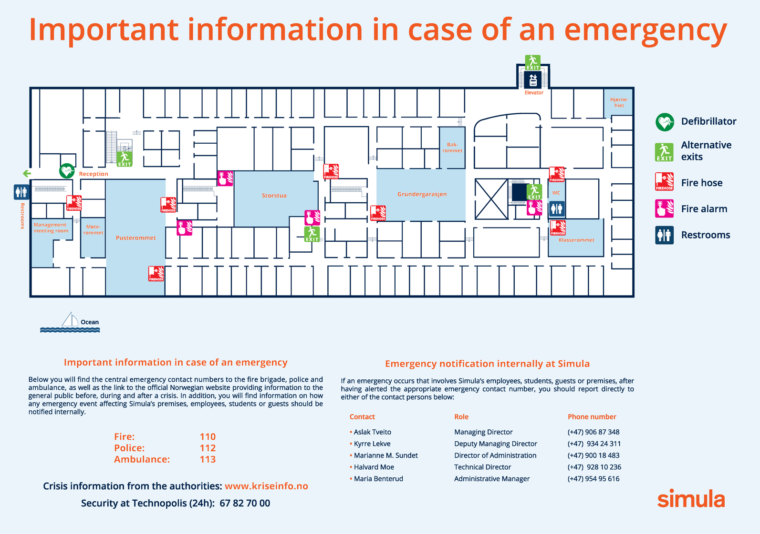

Bakrommet
Storstua
Møterommet
Klasserommet

